Slide 1
IntegratIng Large Language Models (LLMs) wIth Spectral EstImatIon for Advanced Audio ProcessIng
PRESENTED BY
ZEYNEP İLERİ
AYŞENUR ÖZBEK
TEVFİK EREN YAVUZ
SEMA BALLKAYA
UMUT KILINÇ

Slide 2
IntroductIon to Spectral EstImatIon and LLMs
What is Spectral Estimation?
Spectral Estimation is the process of analyzing a signal to understand its frequency components.
It transforms time-domain signals into frequency-domain information, helping to extract meaningful patterns from audio data.
Relevance to Audio Processing:
Techniques like Fourier Transform (FT), Short-Time Fourier Transform (STFT), and MFCC (Mel Frequency Cepstral Coefficients) are widely used.
These techniques extract features that represent the sound's frequency content over time, critical for speech and audio analysis.
Connection to LLMs (Large Language Models):
LLMs are primarily designed for processing language-based data, but they can also benefit from spectral estimation when dealing with audio or speech data.
Spectral features such as MFCCs are first extracted from the raw audio data, then tokenized and embeddedinto vector representations that LLMs can process.
LLMs can perform tasks like speech recognition, emotion detection, and text-to-speech by leveraging these embeddings derived from spectral analysis.

Slide 3
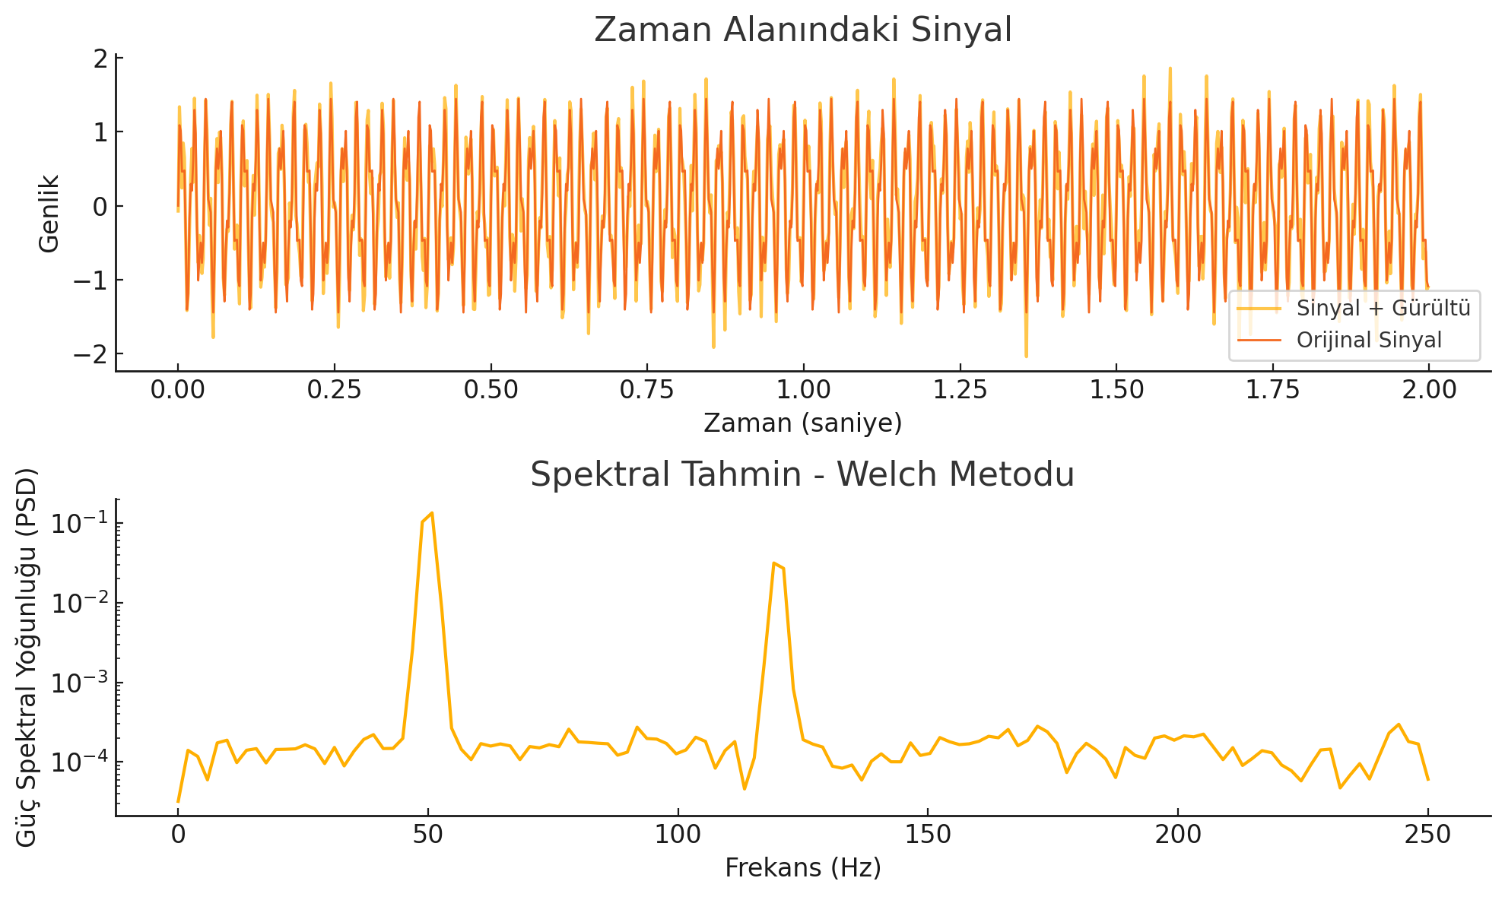
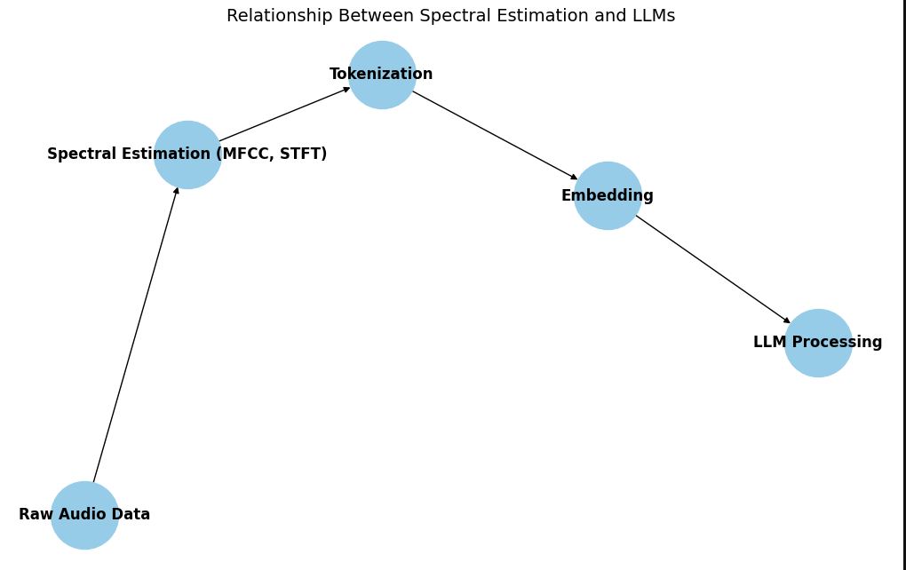
IntroductIon to Spectral EstImatIon and LLMs

Slide 4
TokenIzatIon and EmbeddIng
Tokenization and Spectral Features:
After spectral estimation (e.g., MFCC), the audio data is broken down into smaller units, called tokens.
These tokens represent parts of the audio signal and can be treated similarly to text tokens in NLP tasks.
Embedding:
Once tokenized, the next step is embedding.
Embedding converts the tokens into numerical vectors, which makes it easier for models to analyze and understand the data.
Connection to Machine Learning:
These embedded tokens are fed into deep learning models for tasks like speech recognition or emotion detection.
The embedding process helps capture important features and relationships within the data, improving model performance.
This basic overview provides a simplified explanation of spectral estimation, tokenization, and embedding, and how these concepts are applied in audio signal processing for machine learning tasks.

Slide 5
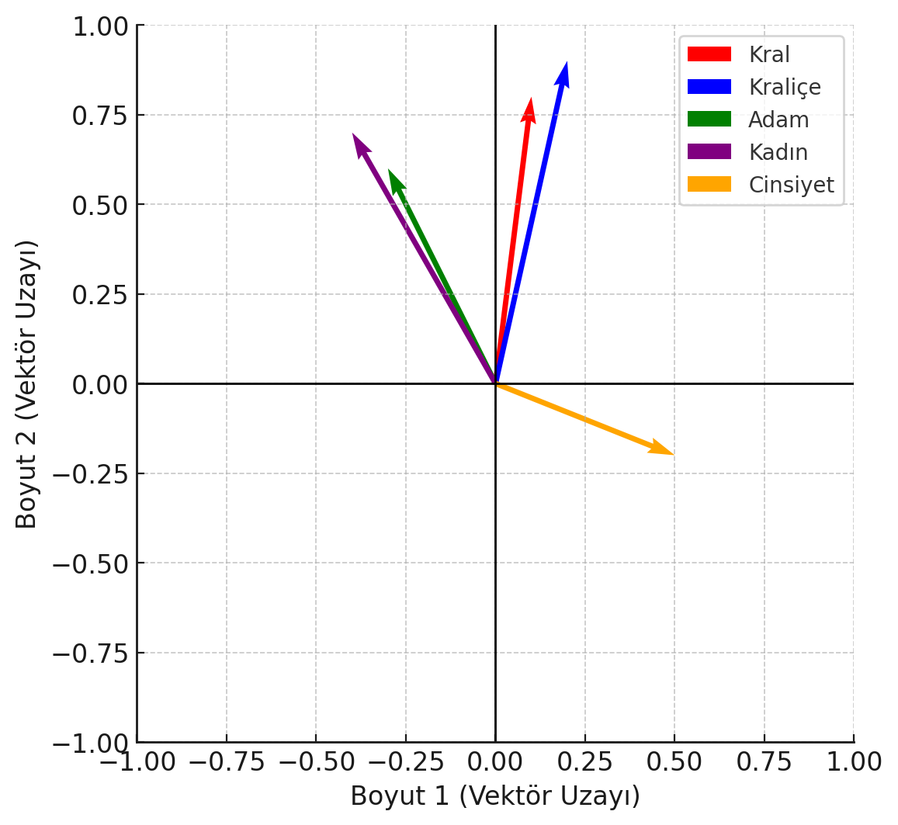
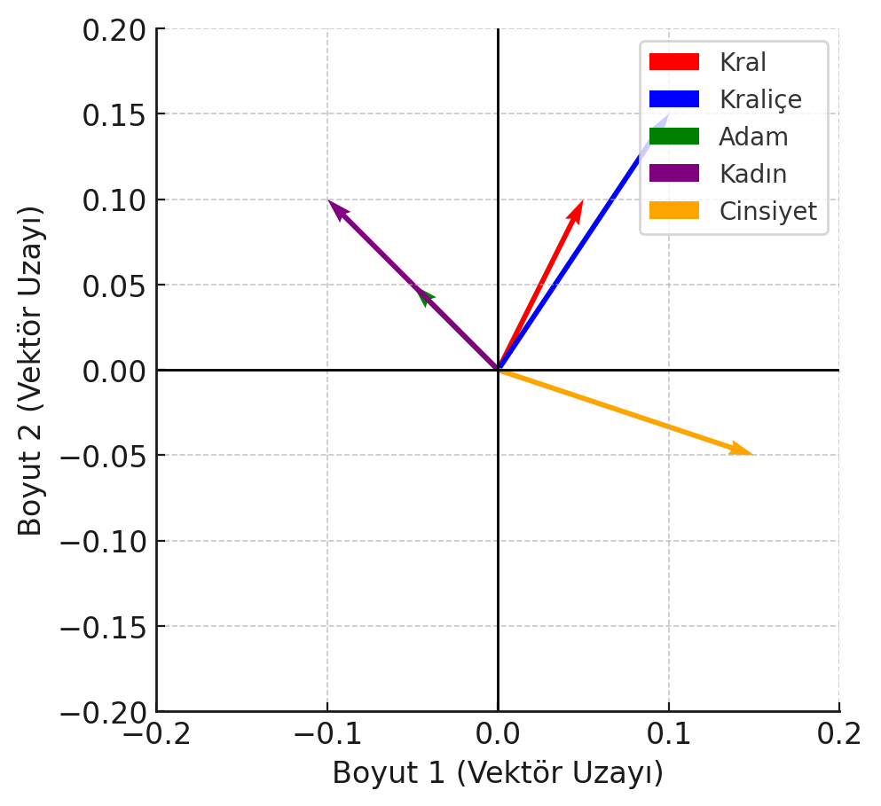
Explaining Embedding and Tokenization - The King and Queen Example
What are Tokenization and Embedding?
Tokenization: This process breaks down data (such as text) into smaller pieces called tokens. For example, the words "King" and "Queen" would each become a token.
Embedding: Tokens are then converted into numerical data (vectors), which allows machine learning models to process them. Each token is represented as a vector, enabling deeper analysis and understanding.
Example - King and Queen:
Tokenization:
Given the text "King Queen", it is broken into tokens:
Token 1: "King"
Token 2: "Queen"
Embedding:
These tokens are represented as numerical vectors. For example:
"King" -> [0.3, 0.7, -0.1]
"Queen" -> [0.4, 0.6, -0.2]
These vectors are created to capture the relationships and meanings of the words. For example, the closeness of the vectors for "King" and "Queen" indicates their similarity.

Slide 6
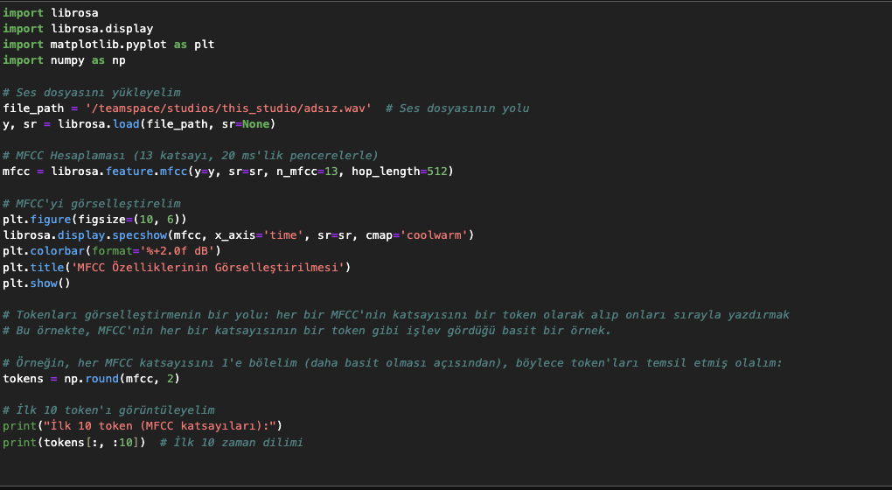
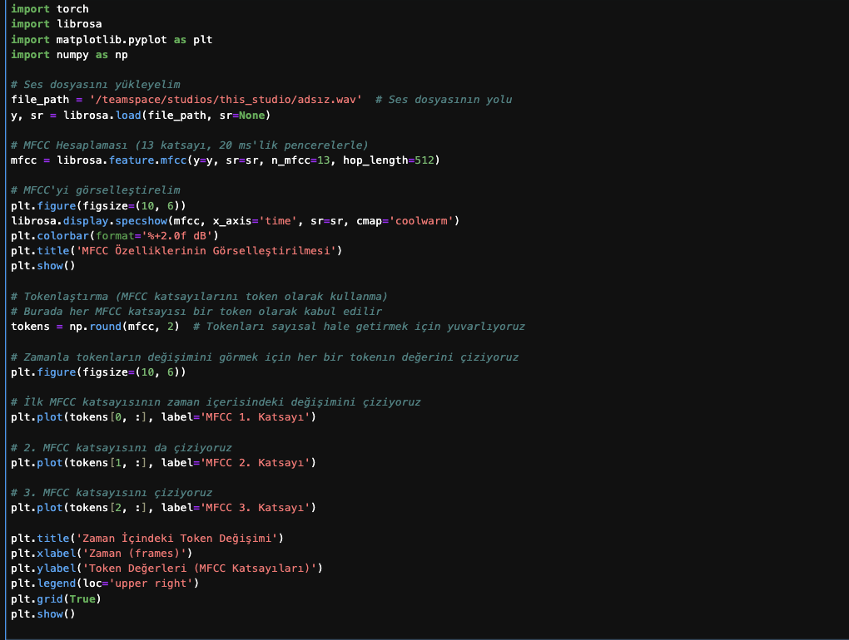
VIsualIzIng MFCC Features and TokenIzatIon In AudIo ProcessIng
MFCC Calculation
Tokenization of MFCC Coefficients

Slide 7
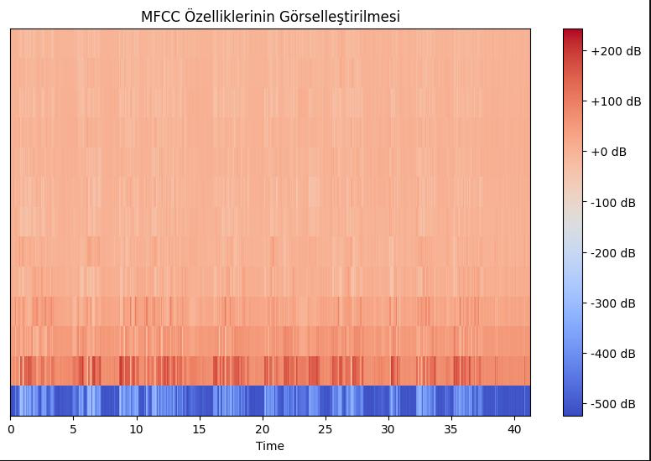
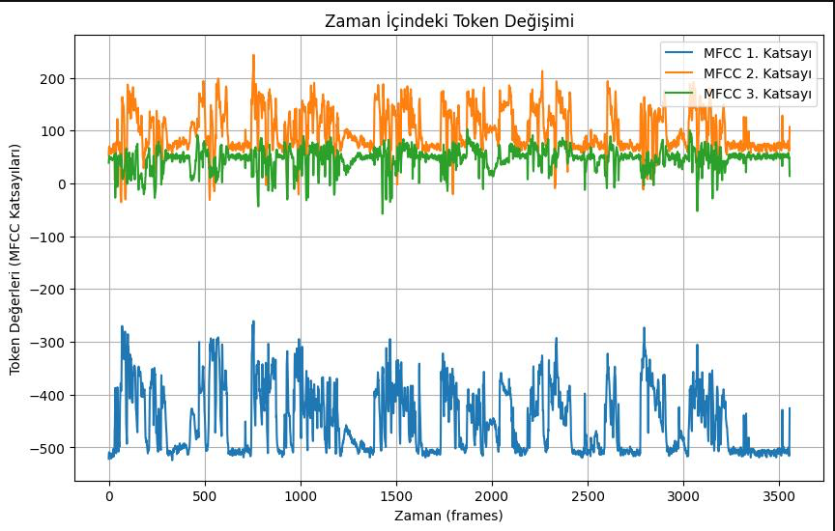
TokenIzatIon and EmbeddIng

Slide 8
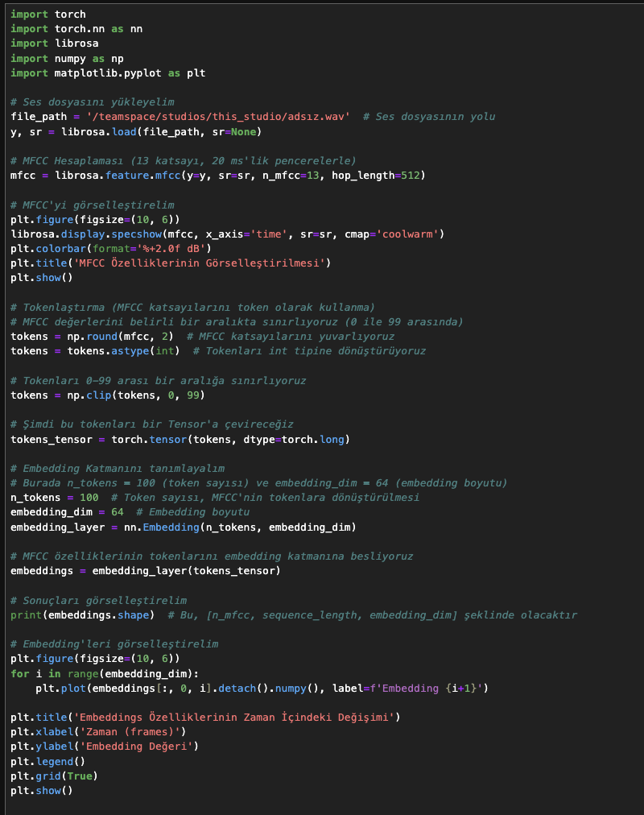
TokenIzatIon, EmbeddIng, and VIsualIzatIon
Feed Tokens into Embedding Layer

Slide 9
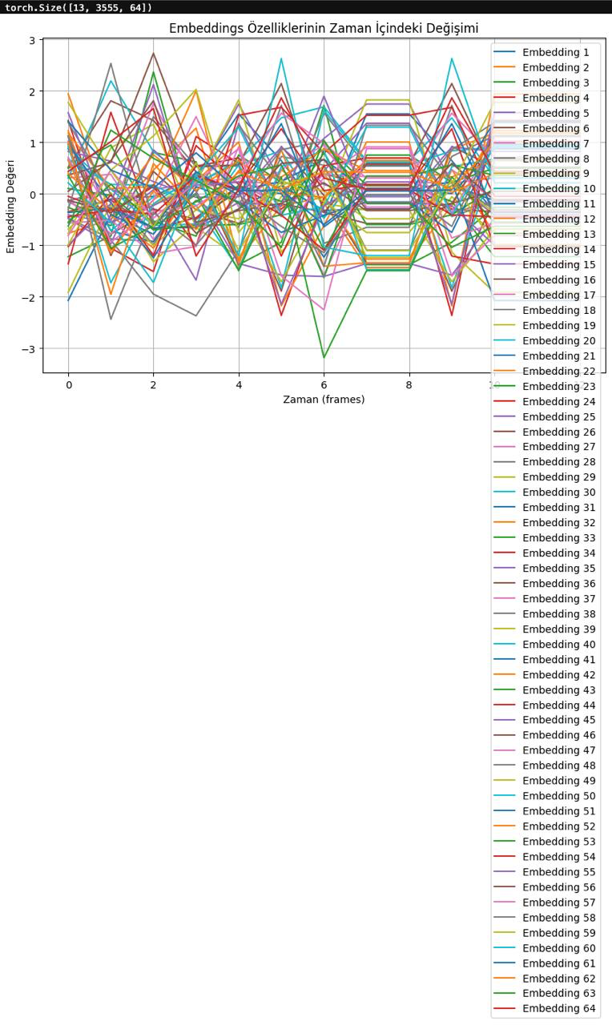
TokenIzatIon and EmbeddIng

Slide 10
PRE-TRAINING
The process of training a model on a large dataset.
Learning the general features of the model (e.g., BERT, ImageNet).
General knowledge can be utilized in more specific tasks.
Image Processing: Object detection, face recognition.
Audio Processing: Speech recognition, emotional analysis.

Slide 11
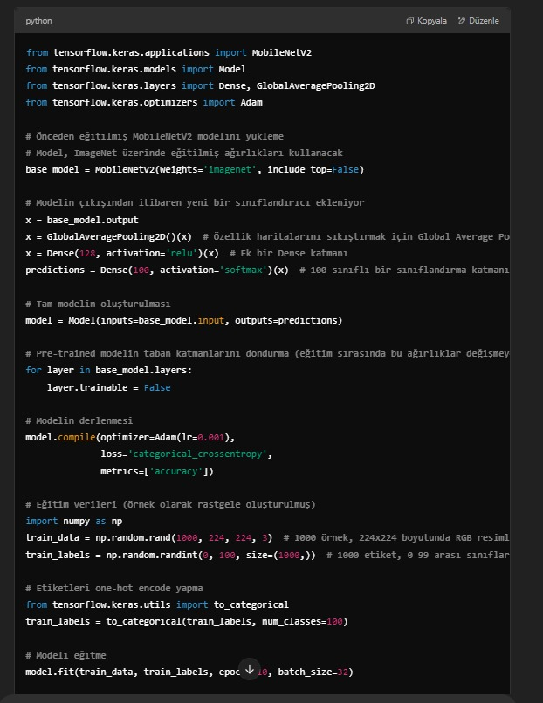
Fıne tunıng
Fine-tuning is optimizing a pre-trained model for a specific task.
Adjusts general knowledge learned during pre-training for specialized tasks. (e.g., BERT, ImageNet)
Achieves high accuracy even with limited data, making it ideal for small datasets.

Slide 12
